Slide 1








Slide 2




Data
Preparation
Developer Survey is collected from over 80K respondents throughout 2019

Slide 3
Data
Preparation
Developer Survey is collected from over 80K respondents throughout 2019

Slide 4

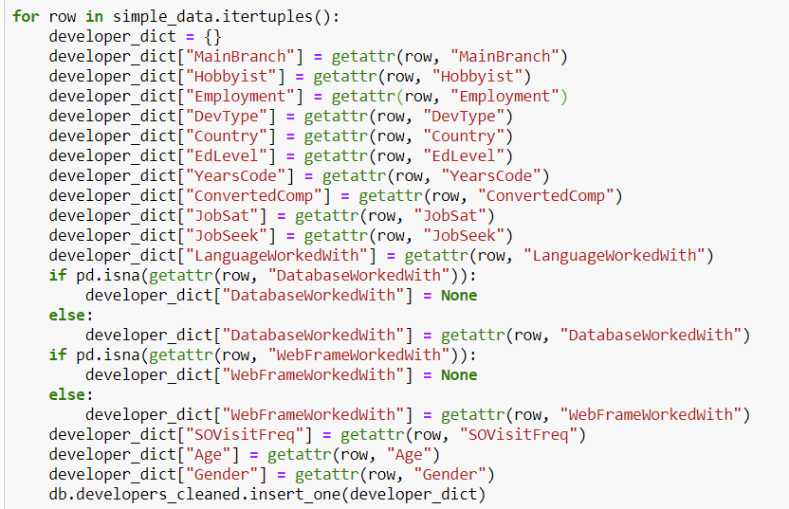
Data
Cleaning
&
MongoDB

Slide 5
Data
Cleaning
&
MongoDB
The dataset was very clean and had lots of information that can be used for different types of analysis

Slide 6



CODING

Slide 7
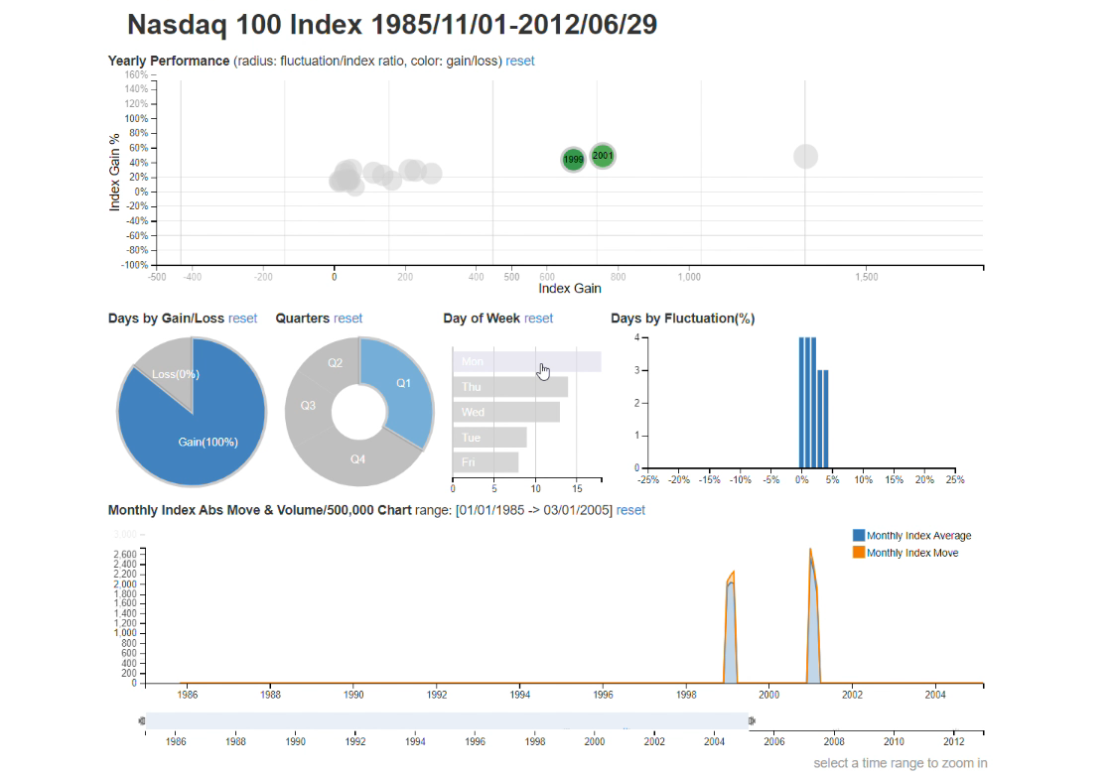
Why?
The project exploited DC.js
Library of Javascript for its
ability to work efficiently with a large dimensional dataset and its native support of Crossilter.

Slide 8
Pros
Great data visualization.
Performs graphical filtering.
Fast creation of charts and dashboards.
Creation of highly interactive dashboards.
Cons
Extremely buggy.
Lots of workarounds even for the simplest tasks.
Many conflicting solutions.

Slide 9
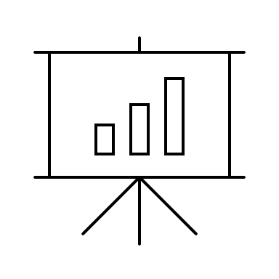


Analysis

Slide 10
What?
This project is aimed at building interactive charts showing the relationship between Development Type, Programming Languages used, Compensation of respondents converted to USD, and Job Satisfaction.

Slide 11
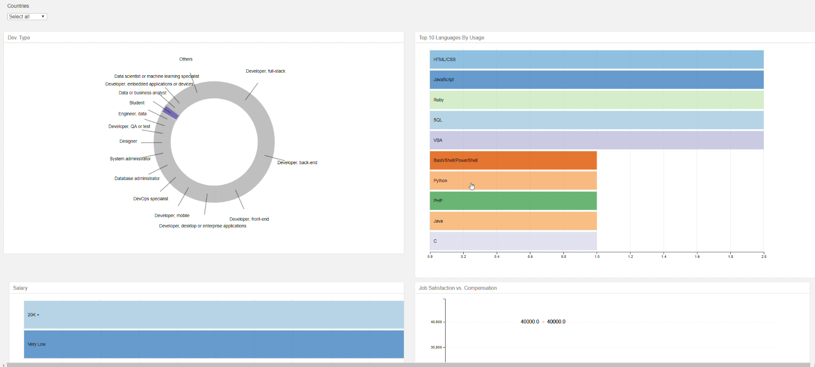
Results?
The resulting tool is visually pleasant and easy to use. By clicking on the specific parts of the charts, the user can get idea on which languages are most popular to a specific domain and most common compensations. All this can be filtered by country, which is available to user as drop-down menu.

